Slide 1
C++
Numbers

Slide 2
Today we will look at
What did we learn last week?
Numbers

Slide 3
Comments
/*
comments do NOT show what comments should describe WHY
*/
int vat = 20; // UK tax rate
Improve this?

Slide 4
Data types
Every variable has a type
Represents the data that can be stored in it
Informs the compiler how much memory to set aside for it
Informs the compiler what operations can be performed on it

Slide 5
Data Type | Size in Bytes | Range
int | 4 | -2,147,483,648 to 2,147,483,647
char | 1 | -127 to 127 or 0 to 255
bool | 1 | 0 to 1
float | 4 | +/- 3.4e +/- 38 (~7 digits)
double | 8 | +/- 1.7e +/- 308 (~15 digits)

Slide 6
Int vs float
4 is an int
4.0 is a float
The compiler sees these differently (type)

Slide 7


numbers
In English -- 10,000 Scientific -- 1 * 10⁴
C++ -- 1E4

Slide 8
Numbers int and float
Can you convert an int to a float?
Can you convert a float to an int?

Slide 9
Numbers int and float
Can you convert an int to a float?
Can you convert a float to an int?
If the float is within the range of -2147483648 to 2147483647

Slide 10
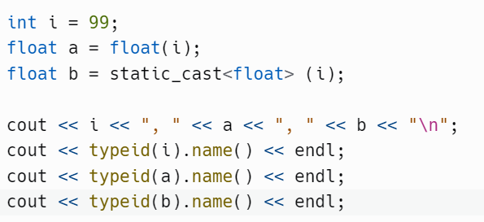
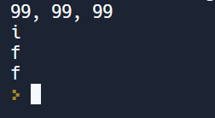

Slide 11
Operators
=
+
-
*
/

Slide 12
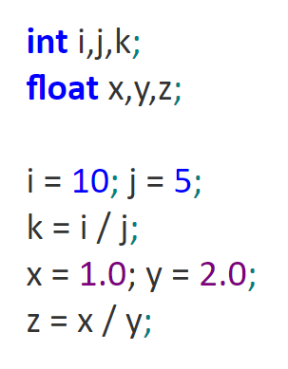
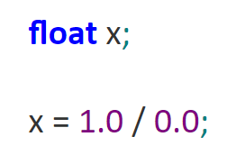
Do types make a difference?

Slide 13
Do types make a difference?
main.cpp:7:16: warning: division by zero
exit status -1

Slide 14
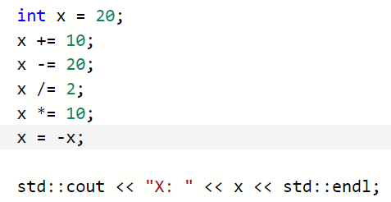
Assignment operators

Slide 15
Increment and decrement operators
Postfix
a++
a--
Prefix
++a
--a
float x = 9.5;
x++;

Slide 16
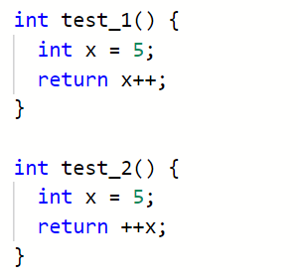


Slide 17
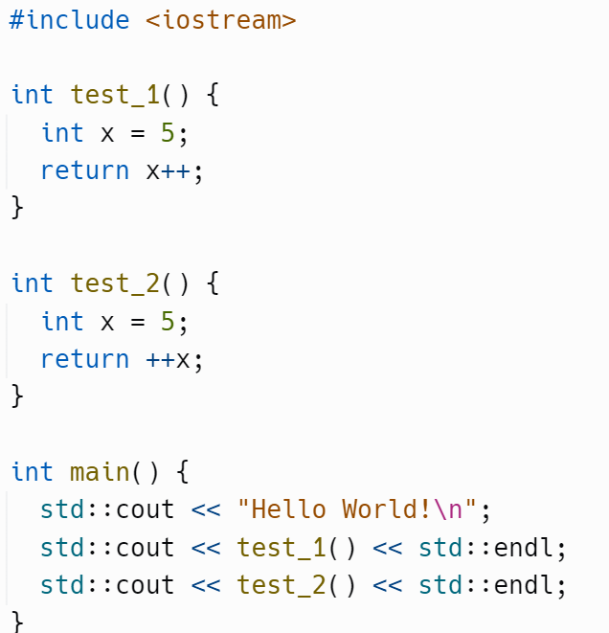

What will this output?
Try it!!

Slide 18
Create a program that …
Investigate float and double
Measure the min and max numbers each can hold
What happens if you add one to max value?
If you subtract one from min value?
Investigate the range of float values you can convert to an int
Write a program that investigates these arithmetic operators
Remember, these little programs will be your revision guides for the exam.
+a -a a + b a - b a * b a / b a % b a << b a >> b

Slide 19
\n Newline Moves the cursor to the next line
\t Horizontal tab Moves the cursor to the next tab stop (be careful)
\a Alarm Causes the computer to beep
\\ Backslash Causes a backslash to be printed
\’ Single quote Causes a single quotation mark to print
\” Double quote Causes a double quotation mark to print

